Slide 1
2019 Independent Medical Sales Representative Survey
Monday, January 06, 2020

Slide 2
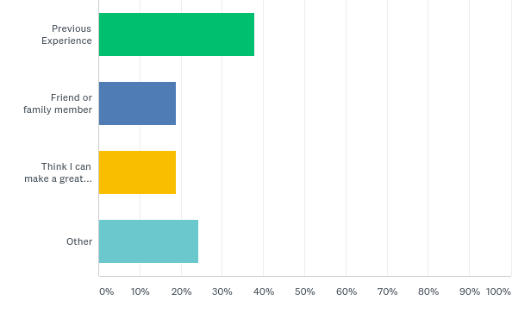
Q1: What led you to become an independent medical sales rep?

Slide 3
Q1: What led you to become an independent medical sales rep?

Slide 4
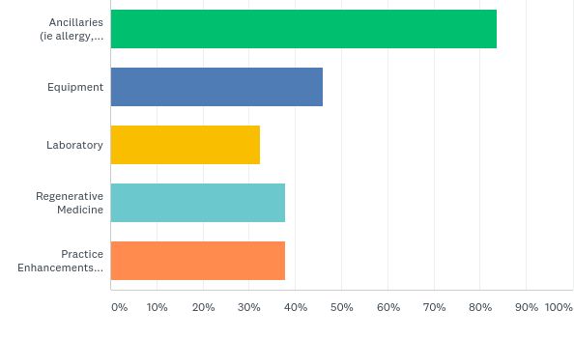
Q2: Which ancillary sectors are of most interest to you ?

Slide 5
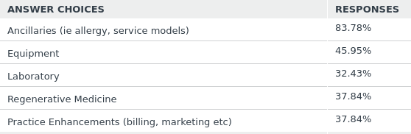
Q2: Which ancillary sectors are of most interest to you ?

Slide 6
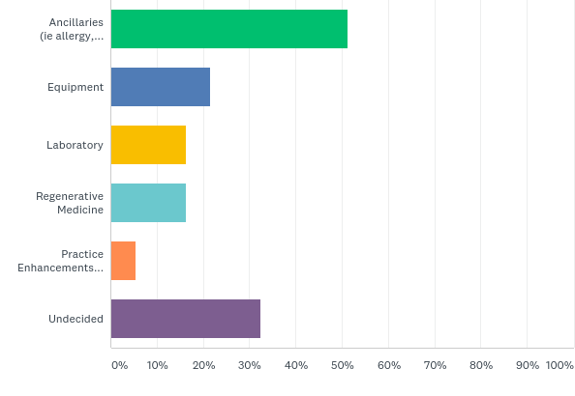
Q3: Which ancillary sectors have you had the most success ?

Slide 7
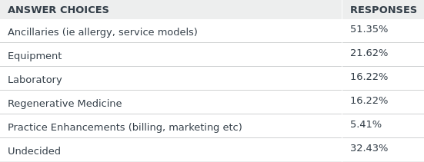
Q3: Which ancillary sectors have you had the most success ?

Slide 8
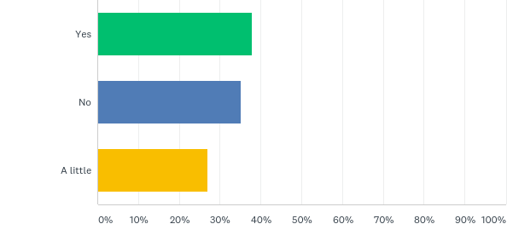
Q4: Have you ever been concerned in not trusting your Vendors or Distributors ?

Slide 9
Q4: Have you ever been concerned in not trusting your Vendors or Distributors ?

Slide 10
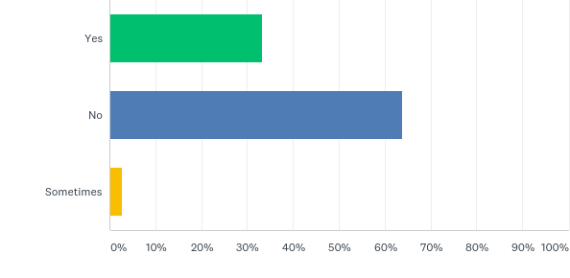
Q5: Has a Vendor ever NOT paid you ?

Slide 11
Q5: Has a Vendor ever NOT paid you ?

Slide 12
Q6: Has a Distributor ever NOT paid you ?

Slide 13
Q6: Has a Distributor ever NOT paid you ?

Slide 14
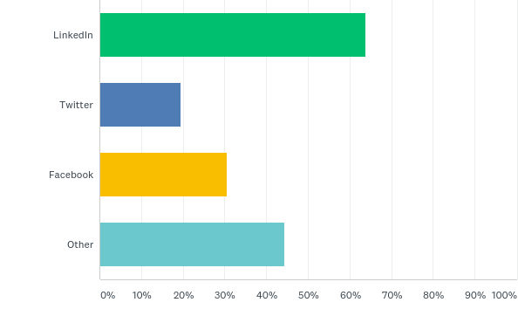
Q7: Do you connect with your Prospects through Social Media ?

Slide 15
Q7: Do you connect with your Prospects through Social Media ?

Slide 16
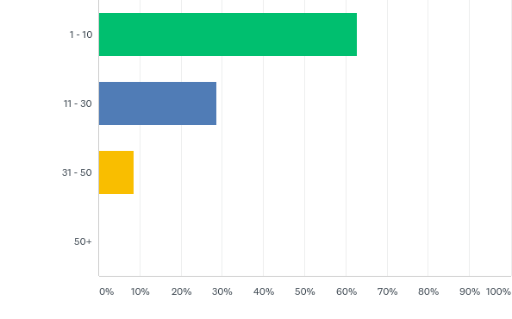
Q8: How many face to face interactions with HCPs do you have per week ?

Slide 17
Q8: How many face to face interactions with HCPs do you have per week ?

Slide 18
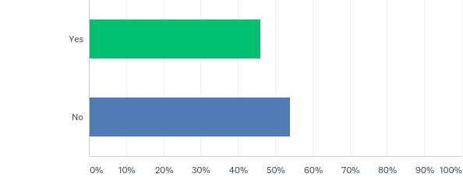
Q9: Have you received any formal medical sales training ?

Slide 19
Q9: Have you received any formal medical sales training ?

Slide 20
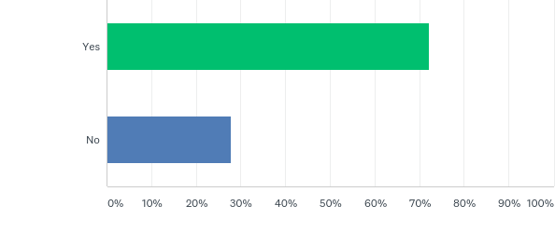
Q10: Have you received any Compliance Training ? (Stark, HIPPA, AKS )

Slide 21
Q10: Have you received any Compliance Training ? (Stark, HIPPA, AKS )

Slide 22
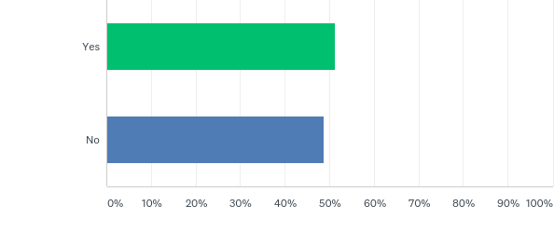
Q11: Do you use a CRM to manage your prospects ?

Slide 23
Q11: Do you use a CRM to manage your prospects ?

Slide 24
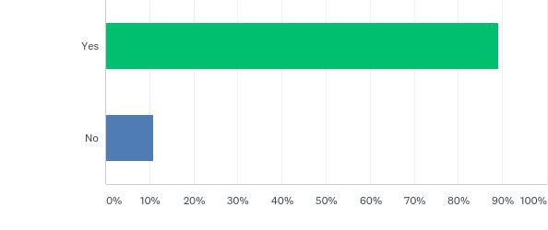
Q12: Do you listen to Sales Podcasts to learn about sales tips & strategies ?

Slide 25
Q12: Do you listen to Sales Podcasts to learn about sales tips & strategies ?

Slide 26
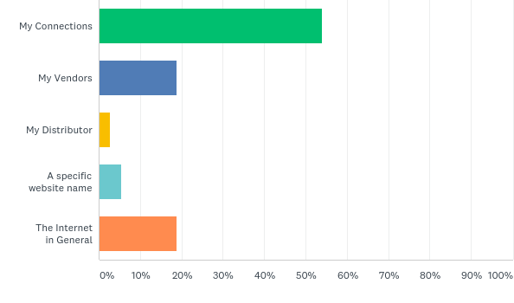
Q13: What is your most valuable resource for driving sales ?

Slide 27
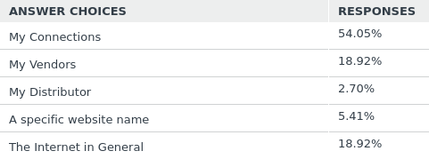
Q13: What is your most valuable resource for driving sales ?

Slide 28
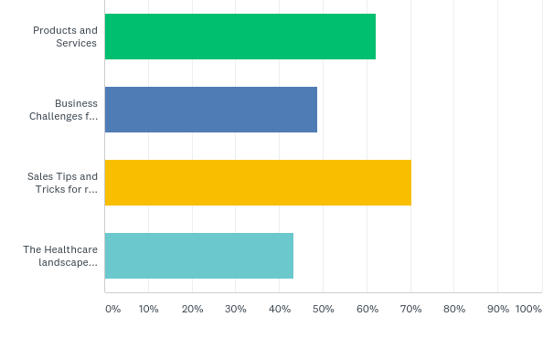
Q14: What area would you most like to know more about ?

Slide 29
Q14: What area would you most like to know more about ?

Slide 30
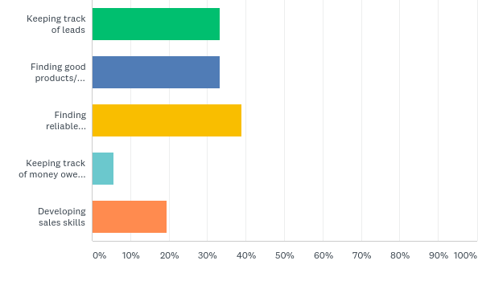
Q15: Which of these areas do you find difficulty ?

Slide 31
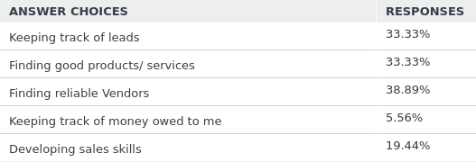
Q15: Which of these areas do you find difficulty ?

Slide 32
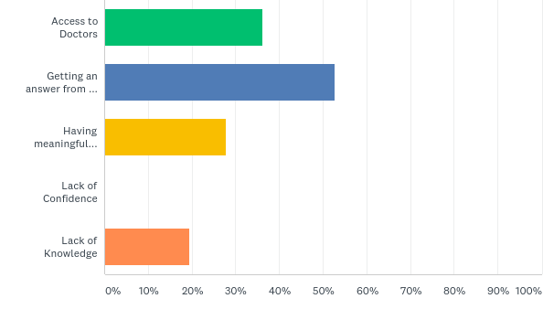
Q16: What do you think is the biggest barrier to successful ?

Slide 33
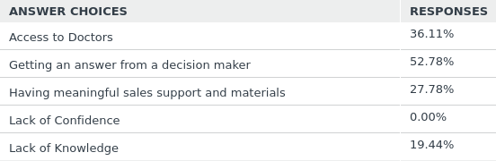
Q16: What do you think is the biggest barrier to successful ?

Slide 34
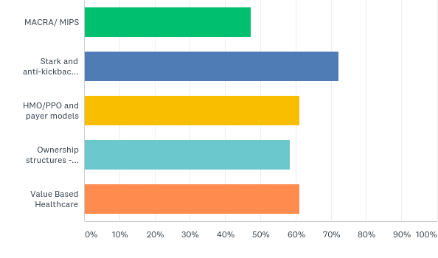
Q17: Which of these do you know about or understand ?

Slide 35
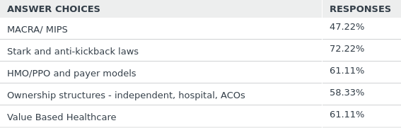
Q17: Which of these do you know about or understand ?

Slide 36
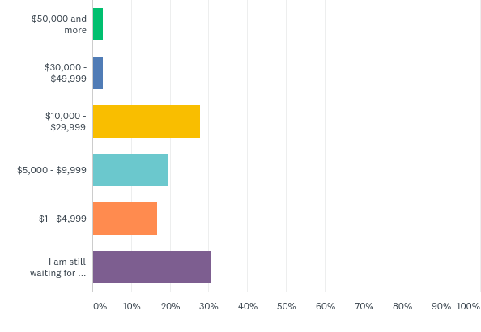
Q18: What is the highest pay you have made in a single month ?

Slide 37
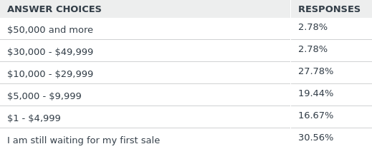
Q18: What is the highest pay you have made in a single month ?

Slide 38
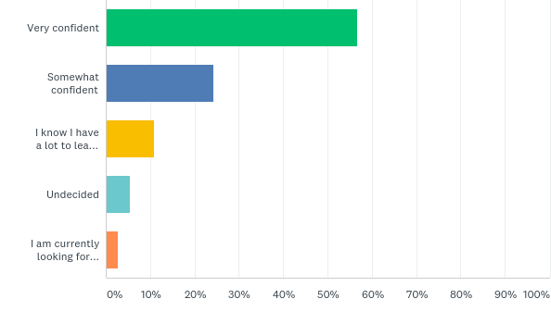
Q19: How confident are you in your future as a Medical Sales Rep ?

Slide 39
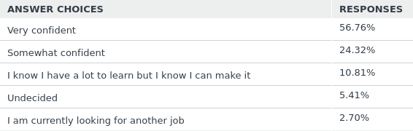
Q19: How confident are you in your future as a Medical Sales Rep ?

